Slide 1

Teamwork Quality and Individual Opportunity for Success through The Reality TV Show Survivor
School of Modeling, Simulation, and Training
University of Central Florida
The Survivors:
MICHAEL ALLEN
BRADLEY KRIZNAR
JESSICA WILLIAMS

Slide 2


Slide 3
If you’re trying to win a solo prize but you’re part of a team
(Think promotions, research grants…)
Is it in your best interest to make sure your team works well together?
Or
Should you just do you and go for the prize?
Notes:
Talk about:
What kind of prizes are these:
Post Project Rewards… promotions…

Slide 4
Mutual Support
within the team
is a
strong indicator
of
opportunity for success.
So if you want that promotion, helping the team will likely be more beneficial than focusing on personal ambitions.

Slide 5

Purpose Statement
Definitions
Updates Since Alpha Review
Background
Related Work
Approach and Data Collection
Results
Findings

Slide 6
The purpose of this study is to explore the relationship between attributes of whole-team teamwork quality and an individual’s likelihood to advance to the final stage of the winner-take-all reality TV show Survivor.
C1: Adapt a model to capture how unique facets of teamwork quality effect team member opportunity for success in post-collaboration competition.
C2: Quantitatively assess which aspects of teamwork (as measured by the Teamwork Quality assessment) are most impactful on individual team members' outcomes in collaborative environments.
C3: If possible, determine effect sensitivity
Notes:
Use survivor as a captured experiment to evaluate TWQ and individual aspects of teamwork and how they relate to post-project reward and opportunity for success

Slide 7

Teamwork Quality (TWQ):
A measure of collaboration… (Hoegl & Gemuenden, 2001)
Team Performance :
The extent to which a team meets established objectives (Hoegl & Gemuenden, 2001)
Individual Success:*
Winning the Individual Prize
Opportunity for Success:
Placing First or in the Final 4
*Note: this is significantly different than much of the current team performance literature which evaluates individual success based on how much the individual feels they contributes (Hoegl & Gemuenden, 2001), (Brown et al., 2016)

Slide 8
Refocused scope:
Dropped individual demographics from study scope
Prioritized on Teams, TWQ, and season winners
Maintained the ability to expand back to ‘Final 4’ in the event we validated our first three hypothesis’.
Because:
Samples were taking between 20-40 minutes to collect.
Coding requirements for individual demographic data exceeded current study capability

Slide 9

Often, professional collaborative teams:
Are Ad hoc (Stone et al., 2010)
Are Multidisciplinary/Transdisciplinary (Zeigler, 1990), (Flowers et al., 2000)
Account for individual and team success differently (Brown et al., 2016)
Do NOT have singularly aligned interests (Garrett-Jones et al., 2005)
Even though many collaborative projects are non-competitive in nature, there are often post-project rewards that are competitive at the individual level
(e.g., promotion, follow-on job opportunity, consideration for next grant…).

Slide 10
What is Survivor?
A game where 20 people compete to win a grand prize of $1Million.
How does teamwork factor in?
Players begin the game on a team.
The teams compete in a challenge and the loser sends someone home.
At a predetermined point, the teams dissolve and it goes to ‘everyone for themselves’.
Opportunity For Success?
Only the Final 4 get to compete in final round, and only 1 person can win the game.
Team 1 = 10
Team 1 = 10
3
Yay!
Until
Merge
1
8
Until
Winner
Challenge Event:
Red Team Loses
2
9
Individuals
8
Team 2 = 10
Team 2 = 9
6
7
5
4

Slide 11
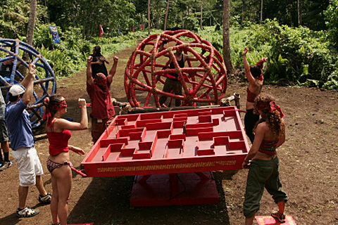

Ad hoc teams
Wide variety of people
Unfamiliar challenges that require intense teamwork (great lab setting)
OVERTLY individual contest that involves intense teamwork dynamics
‘Roll With It!’, S20E04; S30E03; [retrieved from CBS]
‘We Got A Rat’, S31E03, [retrieved from CBS]

Slide 12
Pearsall, Christian, & Ellis (2010) discussed the effects of individual rewards on individual behavior in team settings
They identified that when individual rewards are employed, there is a stronger connection between behavior and outcomes; however, team members are not encouraged to focus attention on helping their teammates
This could translate to low Cohesion, Mutual Support, and Effort in teams without high-performing Survivor contestants
By rewarding individual effort, it increases team members' focus on their individual tasks rather than overall teamwork – with the hope that the cumulative individual efforts will result in adequate team performance overall
However, this generates proself motivation, essentially when members attempt to maximize their own outcomes without regard for the outcomes of the team as a whole
This type of behavior is seen frequently in Survivor, and termed "strategizing" by the community
Johnson et al. (2006) identified that individual reward structures lead to reduced levels of information sharing in teams
Notes:
What’s out there and how does it apply to Survivor? This leads into the things we decided to look at in Survivor (our research questions) and then guides how we came to the approach we chose.

Slide 13
According to De Dreu, Nijstad, & Van Knippenberg (2008), teams combine individual resources and preferences to come to decisions through communication
Team members can develop a shared understanding of the task, resolve disputes or differences in preferences, and produce a solution as a team
Individuals with prosocial motivation shows high levels of accurate information exchange in teams regarding preferences and priorities; however, individuals with proself motivation show high levels of strategic misrepresentation in information exchange
When an individual knows that another team member lacks information (Boles, Croson, & Murnighan, 2000) or if it is a high cost/benefit situation (Tenbrunsel, 1998), there is an increase in levels of deception
When an individual has experience with a task (Murninghan et al., 1999), when the other member is a stranger (Scheitzer & Croson, 1999), or when the individual is aiming to maximize the likelihood of personal gains rather than focusing on overall team gains (Steinel & De Dreu, 2004), misrepresentation of information is more likely
"In short, group members with a prosocial motive are more likely to communicate accurate information, whereas group members with a proself motive engage in more lying, deception, and misrepresentation, especially when there is opportunity to do so and doing so may result in personal gains." (De Dreu, Nijstad, & Van Knippenberg, 2008, pg. 34)
Notes:
So the body of literature is there to suggest that, intentional or otherwise, the existence of individual rewards that are extraneous to team goals interferes with attitudes towards collaboration.

Slide 14
What facet(s) of team collaboration are the best indicators of producing opportunity for success?
What relationship exists between the season winners / top 4 and their seminal team’s overall TWQ in early gameplay?
What can people leading teams take away to most effectively implement in ‘real life’?

Slide 15

Martin Hoegl and Hans Georg Gemuenden’s (2001) Teamwork Quality (TWQ) framework provided a useful tool:
Quantitatively measure TWQ with 38 measures across 6 facets, including collaboration, cohesion, and effort.
This tool is validated and is widely accepted to quantify “quality of teamwork.” (Goodwin et. al, 2018)
Easy fit to assess Teamwork Quality in the setting of Survivor
Provides outputs that are readily comparable with dependent variable, Opportunity for Success

Slide 16
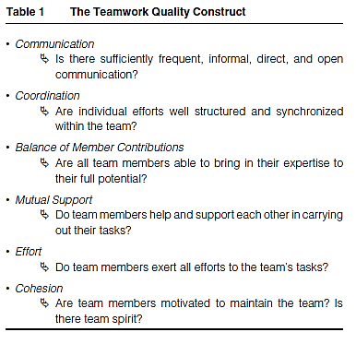
Six Facets of TWQ
10 Measures
5 Measures
3 Measures
6 Measures
4 Measures
10 Measures

Slide 17
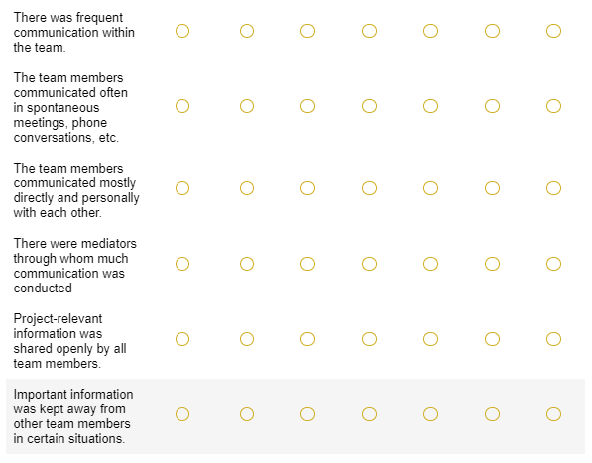
Example TWQ assessment tool Interface for Recorders

Slide 18

To establish group variance among major scoring criteria, first test:
H1: Some facets of TWQ will be significant indicators of opportunity for success for teams
To establish that TWQ varies significantly amongst winning and losing teams:
H2: Teams that win more will have greater overall TWQ scores
If H1 and H2 are significant - to determine definitive season 'winner' opportunity for success significance:
H3: Winning teams will have higher TWQ factor scores when containing a season winner.
If H3 is significant - attempt to determine opportunity for success effect sensitivity among winning and losing teams:
H4: Teams that score higher in overall TWQ will place more contestants in the Final 4 (e.g., wider ranges for opportunities for success).
Notes:
H1: Are some factors significant
H2: Do teams that win more score higher in TWQ
H3: Do Teams with high TWQ make more winners
H4: Focus sensitivity bay evaluating these teams placing people in final 4

Slide 19
More than 125 TWQ tool samples were collected
Required 20 – 45 mins per collection, depending on challenge complexity
Does not include per sample post-collection preparation time
Challenges with several 'phases' qualitatively much more difficult to score for recorders
Data was collected for 5 Survivor seasons (21, 22, 23, 27, 33)
33 episodes evaluated
Covered 96 contestants
5 winners, 20 Final 4
During study, 3 recorders used the TWQ tool to input scoring
More than 7,000 human-input data points

Slide 20
All recording was initially aggregated through Qualtrics
Raw data was exported from Qualtrics to CSV
TWQ questions that were reverse coded ("lower is better" scoring) were fixed in CSV
Raw response data was scrubbed
Several recorder responses removed due to human data entry errors such as being incomplete or due to a TWQ variable being incorrectly scored
The season winners or 'Sole Survivors' were coded into the team sample as 'present' (1) or 'absent' (0)
Level of a team's 'Final 4' count coded, if present
Performed data analysis (graphing, sig. testing, etc.) primarily using JASP

Slide 21

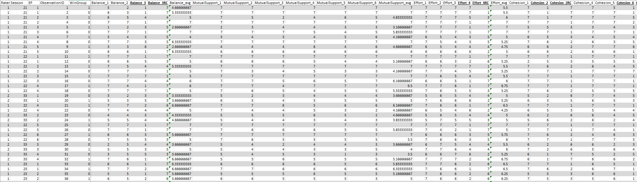
Cleaning and Correction included:
Reverse Coding
Rater Codes
Winner Presence
Quantity in Final 4
Removed Unnecessary Columns of Data
Averaged Across all Average Section Scores

Slide 22

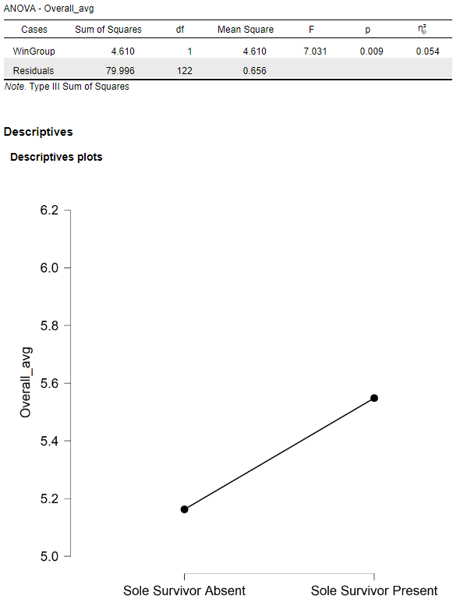
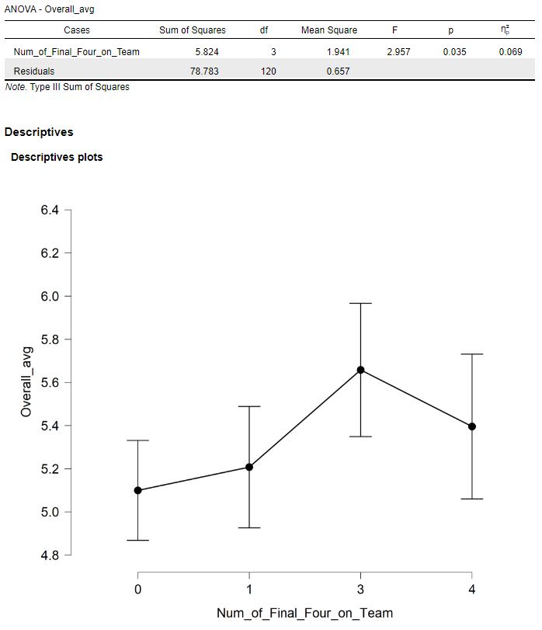
Note: the Y-axis cannot be adjusted in JASP, so please consider this when viewing graphs.
Note: Stats use a 95% CI
ANOVA on Overall average scores on the TWQ:
Similar trends – presence of high performing survivors on teams grouped both by winner (or "Sole Survivor") and number of Final Four survivors produced by the team
Grouping teams by presence of Sole Survivor showing greater significance

Slide 23
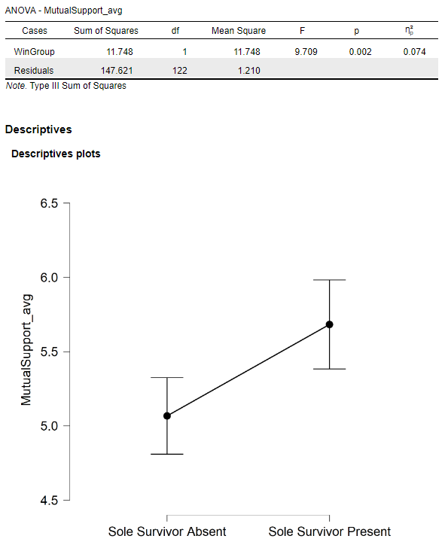
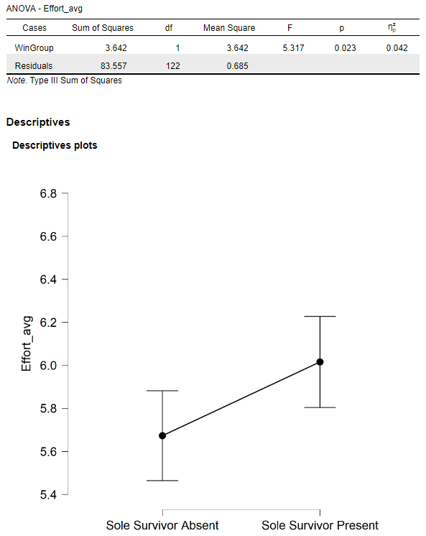
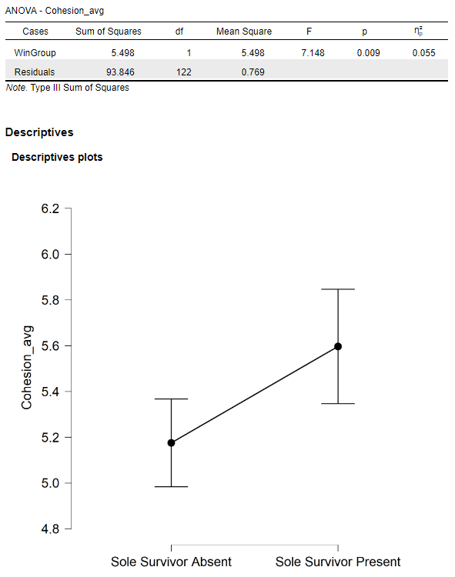
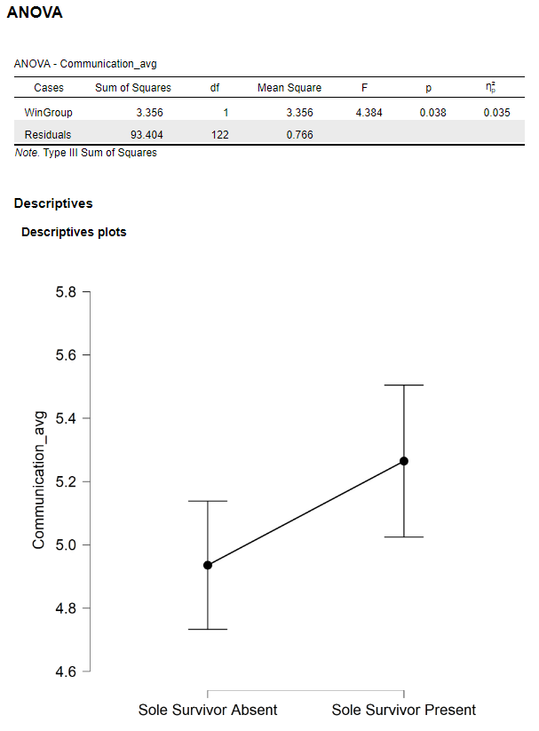
Note: the Y-axis cannot be adjusted in JASP, so please consider this when viewing graphs.
Note: Stats use a 95% CI
ANOVAs shows greater significance in TWQ average scores grouped by presence of Sole Survivor on team:
Mutual Support (p = 0.002)
Cohesion (p = 0.009)
Effort (p = 0.023)
Communication (p = 0.038)

Slide 24
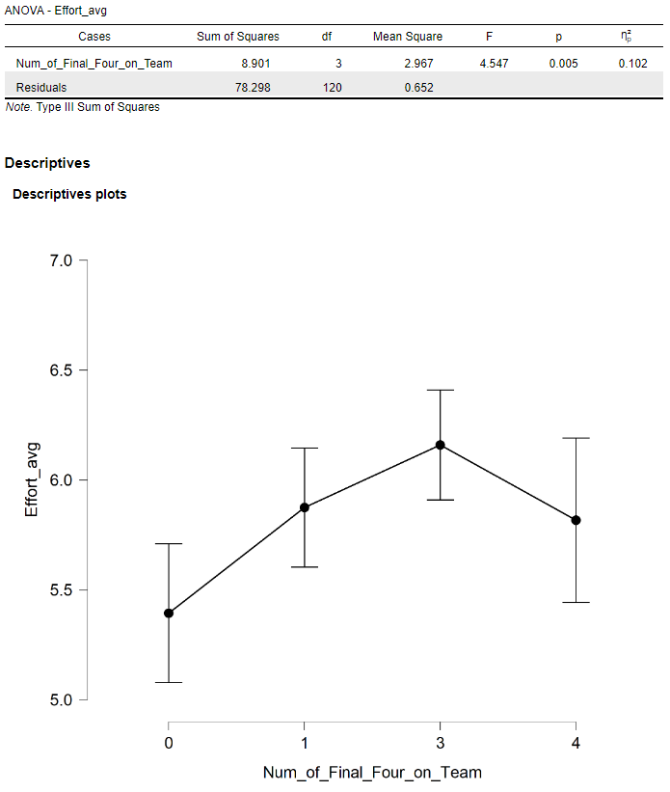
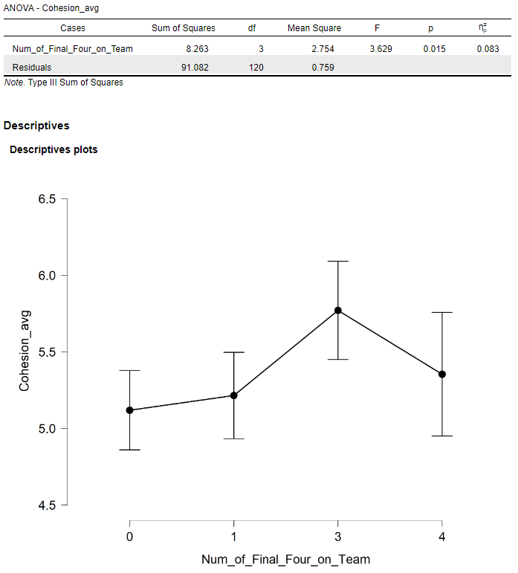
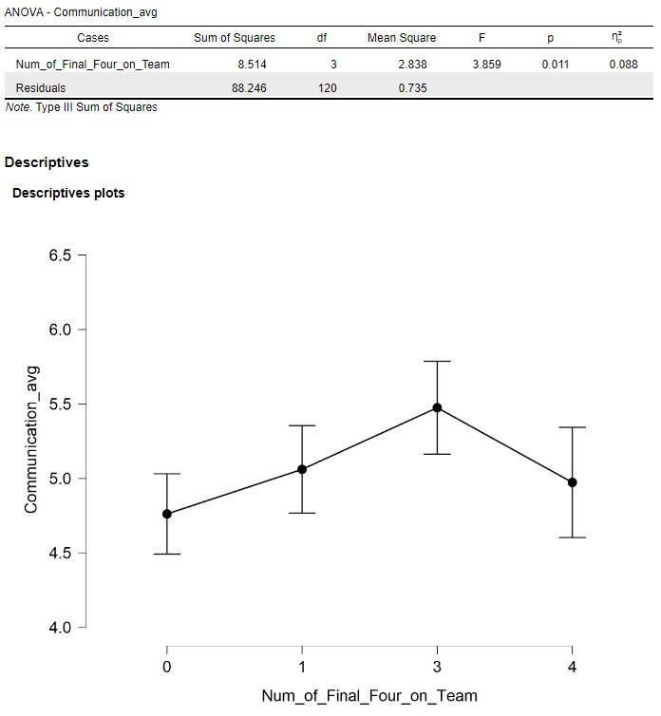
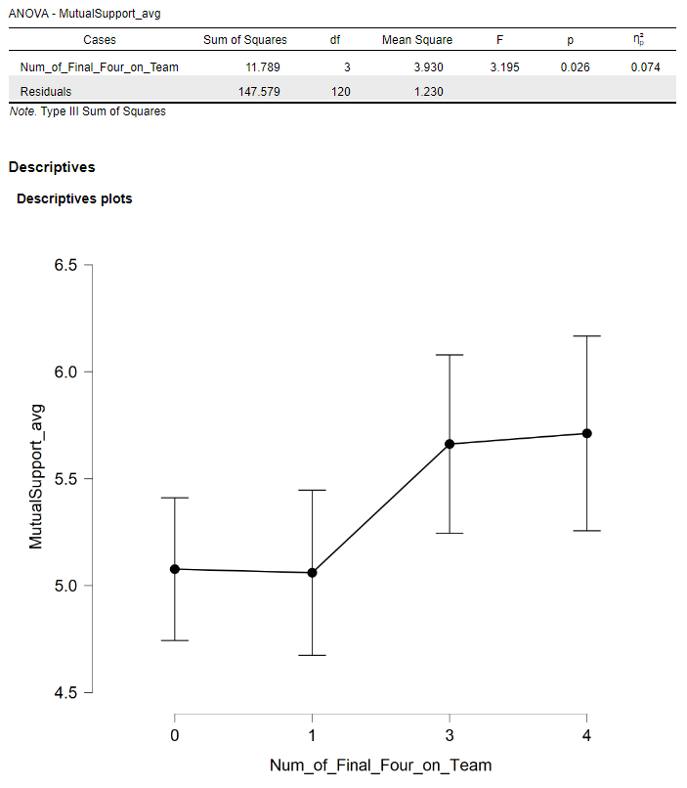
Note: the Y-axis cannot be adjusted in JASP, so please consider this when viewing graphs.
Note: Stats use a 95% CI
ANOVA shows most significant TWQ average scores grouped by number of Final Four produced by team:
Effort (p = 0.005)
Communication (p = 0.011)
Cohesion (p = 0.015)
Mutual Support (p = 0.026)

Slide 25
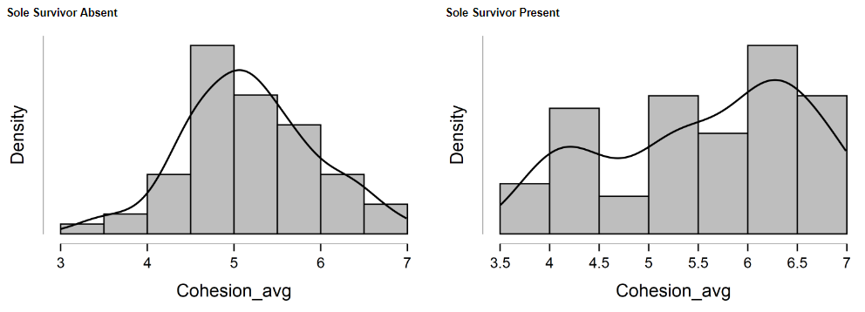
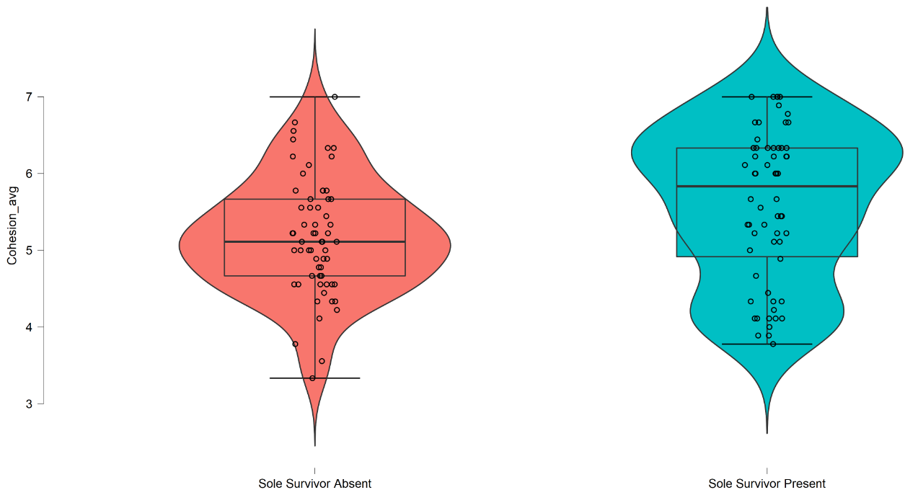
Note: the Y-axis cannot be adjusted in JASP, so please consider this when viewing graphs.
Note: Stats use a 95% CI
Cohesion average scores grouped by Sole Survivor presence:
Shape of the distribution changes with presence of the Sole Survivor
Uni-modal, left-leaning skew to a bimodal, right-leaning

Slide 26
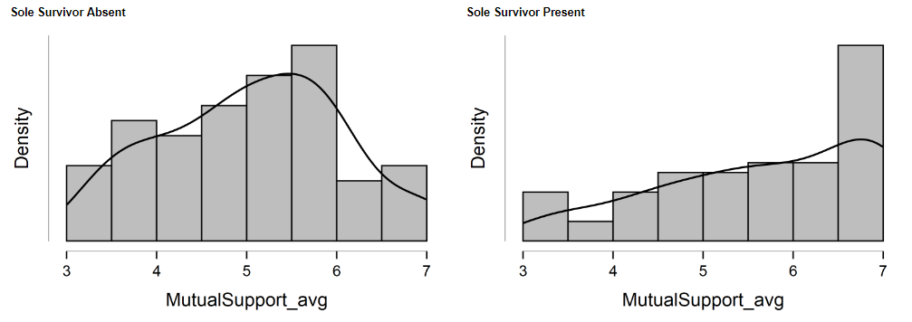
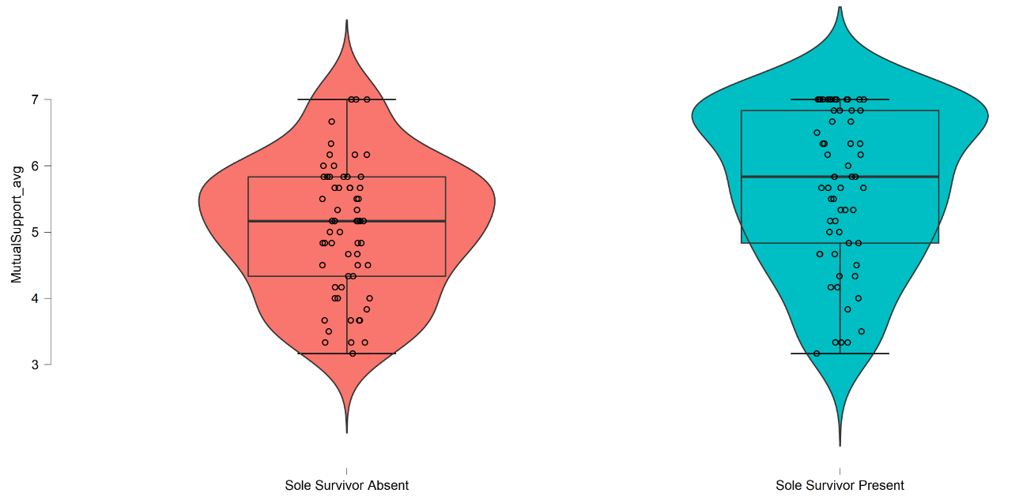
Note: the Y-axis cannot be adjusted in JASP, so please consider this when viewing graphs.
Note: Stats use a 95% CI
Mutual Support average scores grouped by Sole Survivor presence:
Shape of the distribution changes with presence of the Sole Survivor
Much higher density of higher values of average Mutual Support scores

Slide 27
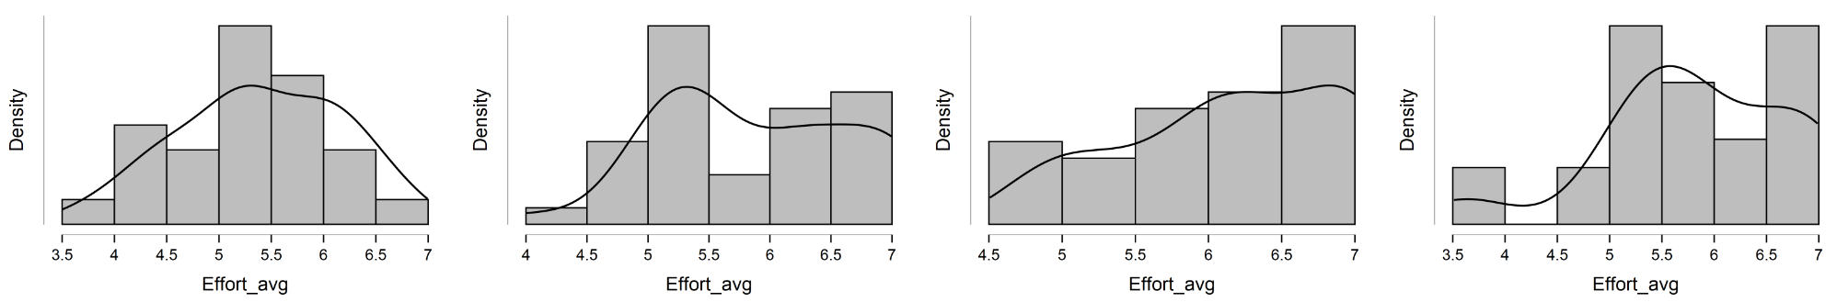
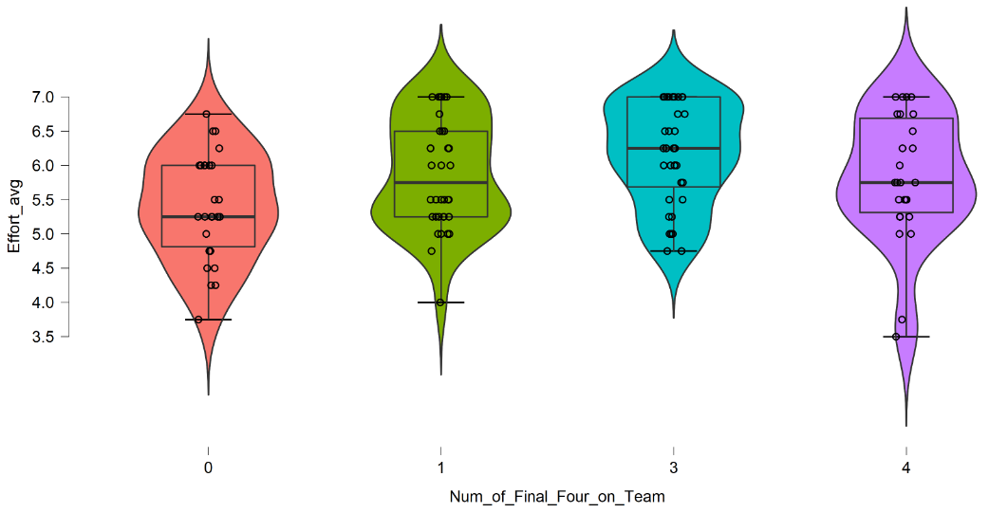
Note: the Y-axis cannot be adjusted in JASP, so please consider this when viewing graphs.
Note: Stats use a 95% CI
Effort average scores grouped by number of Final Four on team:
Shape of the distribution changes with increased number of Final Four Survivors
More averages reported on the higher end of the 7-point Likert scale
Distribution skewed towards higher-values of average scores

Slide 28
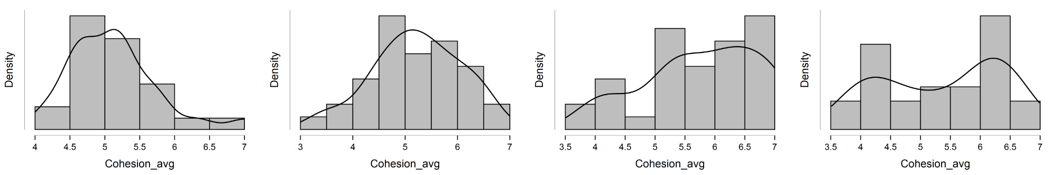
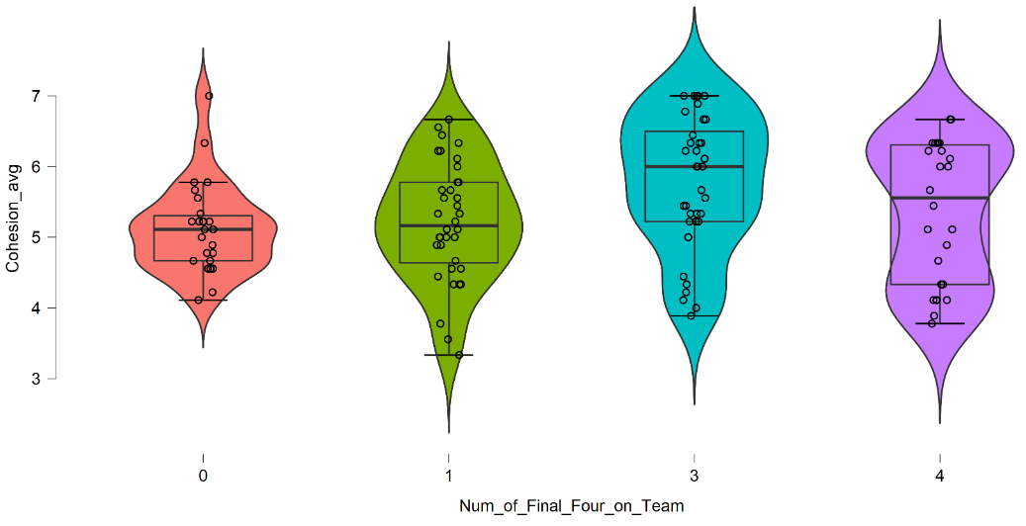
Note: the Y-axis cannot be adjusted in JASP, so please consider this when viewing graphs.
Note: Stats use a 95% CI
Cohesion average scores grouped by number of Final Four on team:
Shape of the distribution changes with increased number of Final Four Survivors
Most prominent difference is when none of the Final Four Survivors come from a team
Indicative of a team that doesn't get along/mesh at all

Slide 29
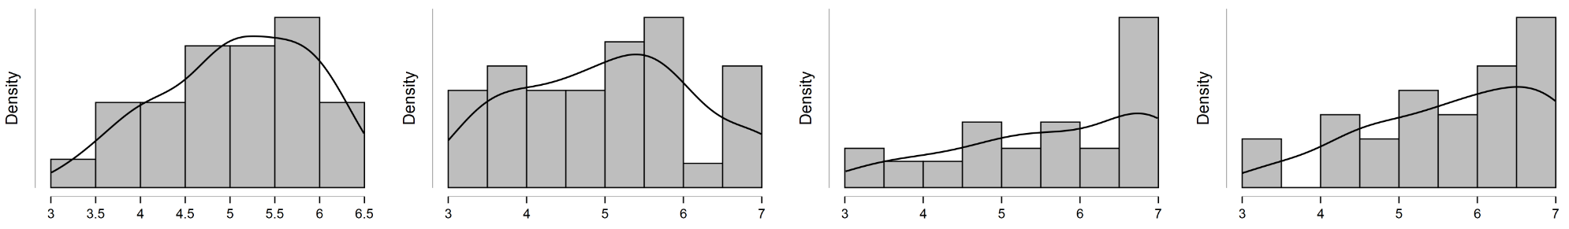
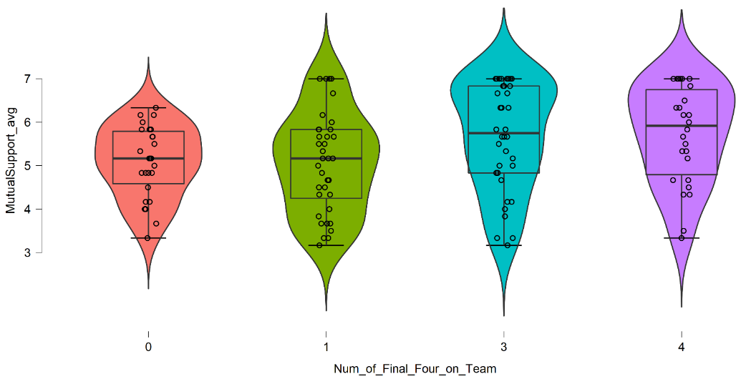
Note: the Y-axis cannot be adjusted in JASP, so please consider this when viewing graphs.
Note: Stats use a 95% CI
Mutual Support average scores grouped by number of Final Four on team:
Shape of the distribution changes with increased number of Final Four Survivors
Most prominent difference is when none of the Final Four Survivors come from a team
Indicative of a team that doesn't get help from each other, cover strengths/weaknesses, etc.

Slide 30
When accounting for season winner presence, the most significant TWQ factors were Mutual Support and Cohesion
All TWQ factors were greater when eventual winner was on team
Should not conflate that this is a ‘great man’ effect and that all credit for improvement is due to eventual winners
Qualitatively, cohesion and mutual support are fundamentally team-first parts of the TWQ
If a ‘great man’ was closely associated with ‘better’ teams, Coordination effect with / without winner would be intuitively expected as most important factor
Study scope did not allow all individual winners to be examined for singular effect size
Suggests that better teams win more, which are likely to produce winners because the tighter team ‘unit’ is more likely to stick together in individual rounds
Mutual support showed the clearest clustering at the score ceiling
Very strong skewing toward upside swing, less pronounced with cohesion or other factors in this instance
Suggests a winning individual strategy is not to ‘enforce’ or dominate team in context of the team’s mental model
More effective to support and have team ‘gel’ even in challenges
This partially captures the ‘social’ elements of the game in non-challenge time

Slide 31
When accounting for ‘top four’, Effort, Cohesion, Communication, and Mutual Support are most significant TWQ factors
Strongly suggests that individuals prioritizing team-focused strategies, such as constructive motivation for teammates, are associated with a greater opportunity for success
‘Tightening’ of outcomes occurring when no top four are on a team
Range of losing outcomes smaller
TWQ performance ceiling for teams within group teams is lower
Suggests that for individual agents, lower-functioning teams make the ‘window’ for
‘Tapering’ and bimodal-shaped outcomes with more top four on a team
Wider range of TWQ scores with higher ceiling
Clustering at ceiling for almost all factors – winners appear to stick together
Floor of team performance nearly the same as lower ‘top 4’ occurrences - few outliers
Suggests there is little ‘risk’ for agents for trying to be more cohesive or supportive in team stages
Notes:
This is where Nash comes in…

Slide 32
Communication, Mutual Support, and, especially, Cohesion are prominent factors in teamwork quality associated with greater performance on Survivor – these aspects together may help facilitate the team's development of shared mental models of the problem spaces they encounter, thereby allowing team members the chance to increase their understanding of the entire process (Fiore & Schooler, 2004)
This may allow teams to adapt to new challenges (game tasks and challenges), coordinate essential taskwork (building shelter, starting fire, etc.), and adapt to team member changes (alliance shifts, merging tribes, etc.)
‘Clustering’ of higher TWQ team scores when evaluating both sole-survivor and top four presence qualitatively aligns with the following:
An effective, longstanding Survivor strategy of ‘locking in’ voting blocs before merge (individual section of game)
That high-performing game players act in interest of the team early
Suggests teams should not cause friction amongst themselves and / or ‘throw’ challenges, make others angry - matters a great deal in end-game
Notes:
Jesi – First Part

Slide 33
Preliminary study results are highly sensitive to sample size
Very clear that the scope amount of data collection required is a challenge
Commitment for human recording was / is immensely taxing
Coding process for recorders has steep learning curve
Review of footage requires access to show episodes
Time commitment, even when ‘proficient’ with TWQ tool, was not trivial
In very ‘fast’ or complex challenges, recorders had to review scenes several times to keep pace with a team
Despite more than 7,000 human-recorded values across 33 episodes, number of samples is still relatively low
Individual demographic information was not factored into study and could severely alter analysis – particularly for ’sole-survivor’
The increasing complexity of hypotheses requires immense amounts of study data to produce robust results
More than 150 team-stage episodes remain
Survivor meta-game changes approximately every 4 – 6 years
Some seasons have rule changes that alter game tempo and ‘valid’ paths to succeed
Ad hoc team challenges in the individual phase of the game were not in scope

Slide 34
More samples, more recorders, more confidence
Potentially review other tools for Hoegl & Gemuenden's TWQ replacement (difficult though – is gold standard)
More robust validation using cross-season comparisons
Break study into several phases focusing on one or two hypothesis at a time
Tracking ‘meta-game’ effect sizes, such as challenge advantages, reward challenge prize wins, etc.
Coding for demographic composition of teams
Addition of scoring player performance across the entire game, including factors such as individual wins, voting patterns, etc.
Inclusion of ad-hoc team TWQ scoring at individual stage of game to study more stochastically formed teams
Also potentially captures more 'social' elements of the game

Slide 35


Slide 36
Boles, T., Croson, R., & Murnighan, J. K. (2000). Deception and retribution in repeated ultimatum bargaining. Organizational Behavior and Human Decision Processes, 83, 235-259.
Cust, E., Sweeting, A., Ball, K., Anderson, H., & Robertson, S. (2019). The relationship of team and individual athlete performances on match quarter outcome in elite women’s Australian Rules football. Journal of Science and Medicine in Sport, 22(10), 1157–1162.
De Dreu, C. K. W., Nijstad, B. A., & Van Knippenberg, D. (2008). Motivated information processing in group judgment and decision making. Personality and Social Psychology Review, 12, 22– 49.
Fiore, S. M., & Schooler, J. W. (2004). Process mapping and shared cognition: Teamwork and the development of shared problem models.
Flowers, N., Mertens, S. B., & Mulhall, P. F. (2000). What Makes Interdisciplinary Teams Effective? Middle School Journal, 31(4), 53–56. https://doi.org/10.1080/00940771.2000.11494640
Garrett-Jones, S., Turpin, T., Burns, P., & Diment, K. (2005). Common purpose and divided loyalties: The risks and rewards of cross-sector collaboration for academic and government researchers. R&D Management, 35(5), 535–544. https://doi.org/10.1111/j.1467-9310.2005.00410.x
Brown, M., Kaine, S., Dolle-Samuel, C., North-Samardzic, A., Mclean, P., Johns, R., O’Leary, P., Plimmer, G., & Robinson, J. (2016). Managing Employee Performance and Reward, Concepts, Practices, Strategies (Second Edition). Cambridge University Press.
Goodwin, G., Blacksmith, N., & Coats, M. (2018). The science of teams in the military: Contributions from over 60 years of research. American Psychologist, 4(73), 322–333.
Hoegl, M., & Gemuenden, H. (n.d.). Teamwork Quality and the Success of Innovative Projects: A Theoretical Concept and Empirical Evidence. Organization Science, 12(4).
Johnson, M. D., Hollenbeck, J. R., Humphrey, S. E., Ilgen, D. R., Jundt, D., & Meyer, C. J. (2006). Cutthroat cooperation: Asymmetrical adaptation to changes in team reward structures. Academy of Management Journal, 49, 103–119.
Landers, D., & Luschen, G. (1974). Team Performance Outcome and the Cohesiveness of Competitive Coating Groups. International Review of Sport Sociology, 9(2), 57–71.
Mcewan, D. (2019). The Effects of Perceived Teamwork on Emergent States and Satisfaction With Performance Among Team Sport Athletes. Sport, Exercise, and Performance Psychology.
Murnighan, J. K., Babcock, L., Thompson, L. L., & Pillutla, M. (1999). The information dilemma in negotiations: Effects of experience, incentives, and integrative potential. International Journal of Conflict Management, 10, 313-339.

Slide 37
Pearsall, M. J., Christian, M. S., & Ellis, A. P. (2010). Motivating interdependent teams: Individual rewards, shared rewards, or something in between?. Journal of Applied Psychology, 95(1), 183.
Schweitzer, M. E., & Croson, R. (1999). Curtailing deception: The impact of direct questions on lies and omissions. International Journal of Conflict Management, 10, 225-248.
Steinel, W., & De Dreu, C. K. W. (2004). Social motives and strategic misrepresentation in social decision making. Journal of Personality and Social Psychology, 86, 419-434
Stone, P., Kaminka, G. A., Kraus, S., & Rosenschein, J. S. (2010, July). Ad Hoc Autonomous Agent Teams: Collaboration without Pre-Coordination. In AAAI (p. 6).
Tenbrunsel, A. E. (1998). Misrepresentation and expectations of misrepresentation in an ethical dilemma: The role of incentives and temptation. Academy of Management Journal, 41, 330-339.
Zeigler EF. 1990. Don’t forget the profession when choosing a name! In The evolving undergraduate major. Edited by CB Corbin and HM Eckert. Human Kinetics, Champaign, Illinois. pp. 67–77.

